Slide 1
Chart Ferox, a.s. Děčín
Význam vodní dopravy při přepravě výrobků

Slide 2
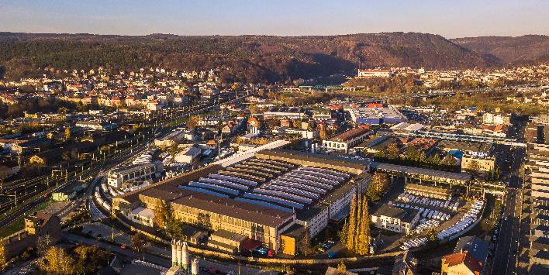
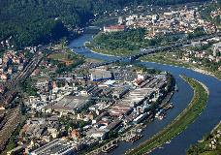
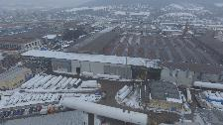

Chart Ferox – 75 years of manufacturing history
A premium leading European manufacturer of highly engineered equipment used in the production, storage and end-use of hydrocarbon and industrial gases.
History of Chart Ferox Facility – Děčín, Czech republic
1941 – 1945 Private company founded by Wilhelm Schmiding
2006 Ferox name changed to Chart Ferox, a.s.
2008 Chart Ferox, a.s. purchased Flow Instruments

Slide 3
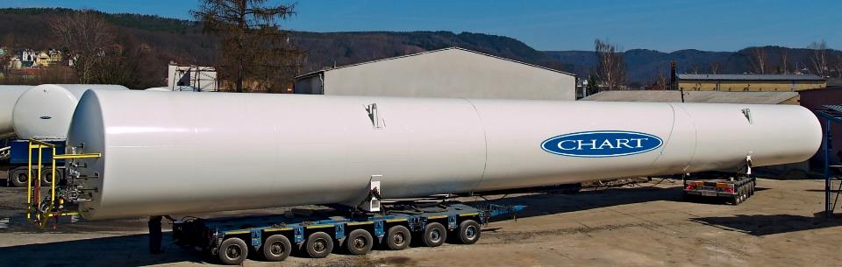
Principal Distribution & Storage Products

Slide 4
Chart Ferox, a.s. products
Typical Product Characteristic (Engineered Tank)
  Weight – 100 - 250 tons
  Lenght – 30 – 60 metres
  Diameter – 4 – 6,5 metres
  Material – carbon/stainless steel
  Transport
    by the river Labe on barges to Hamburg
    Then overseas transport from Hamburg port to final destination
  Storage – in ports

Slide 5
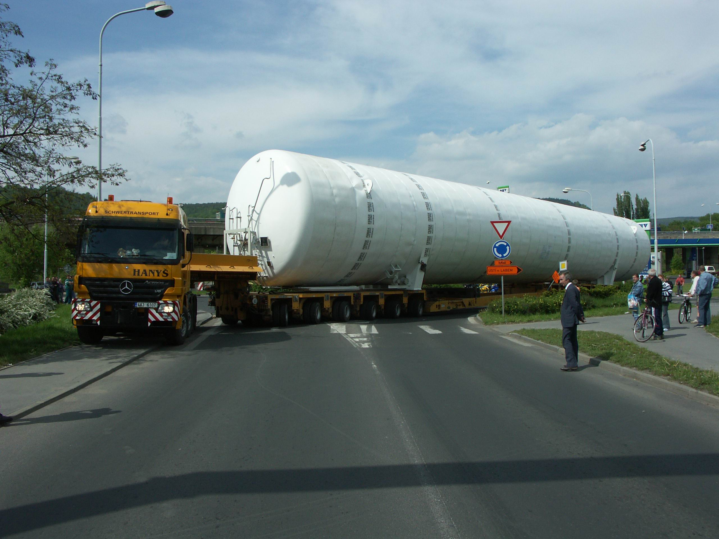
Chart Ferox - Transportation

Slide 6
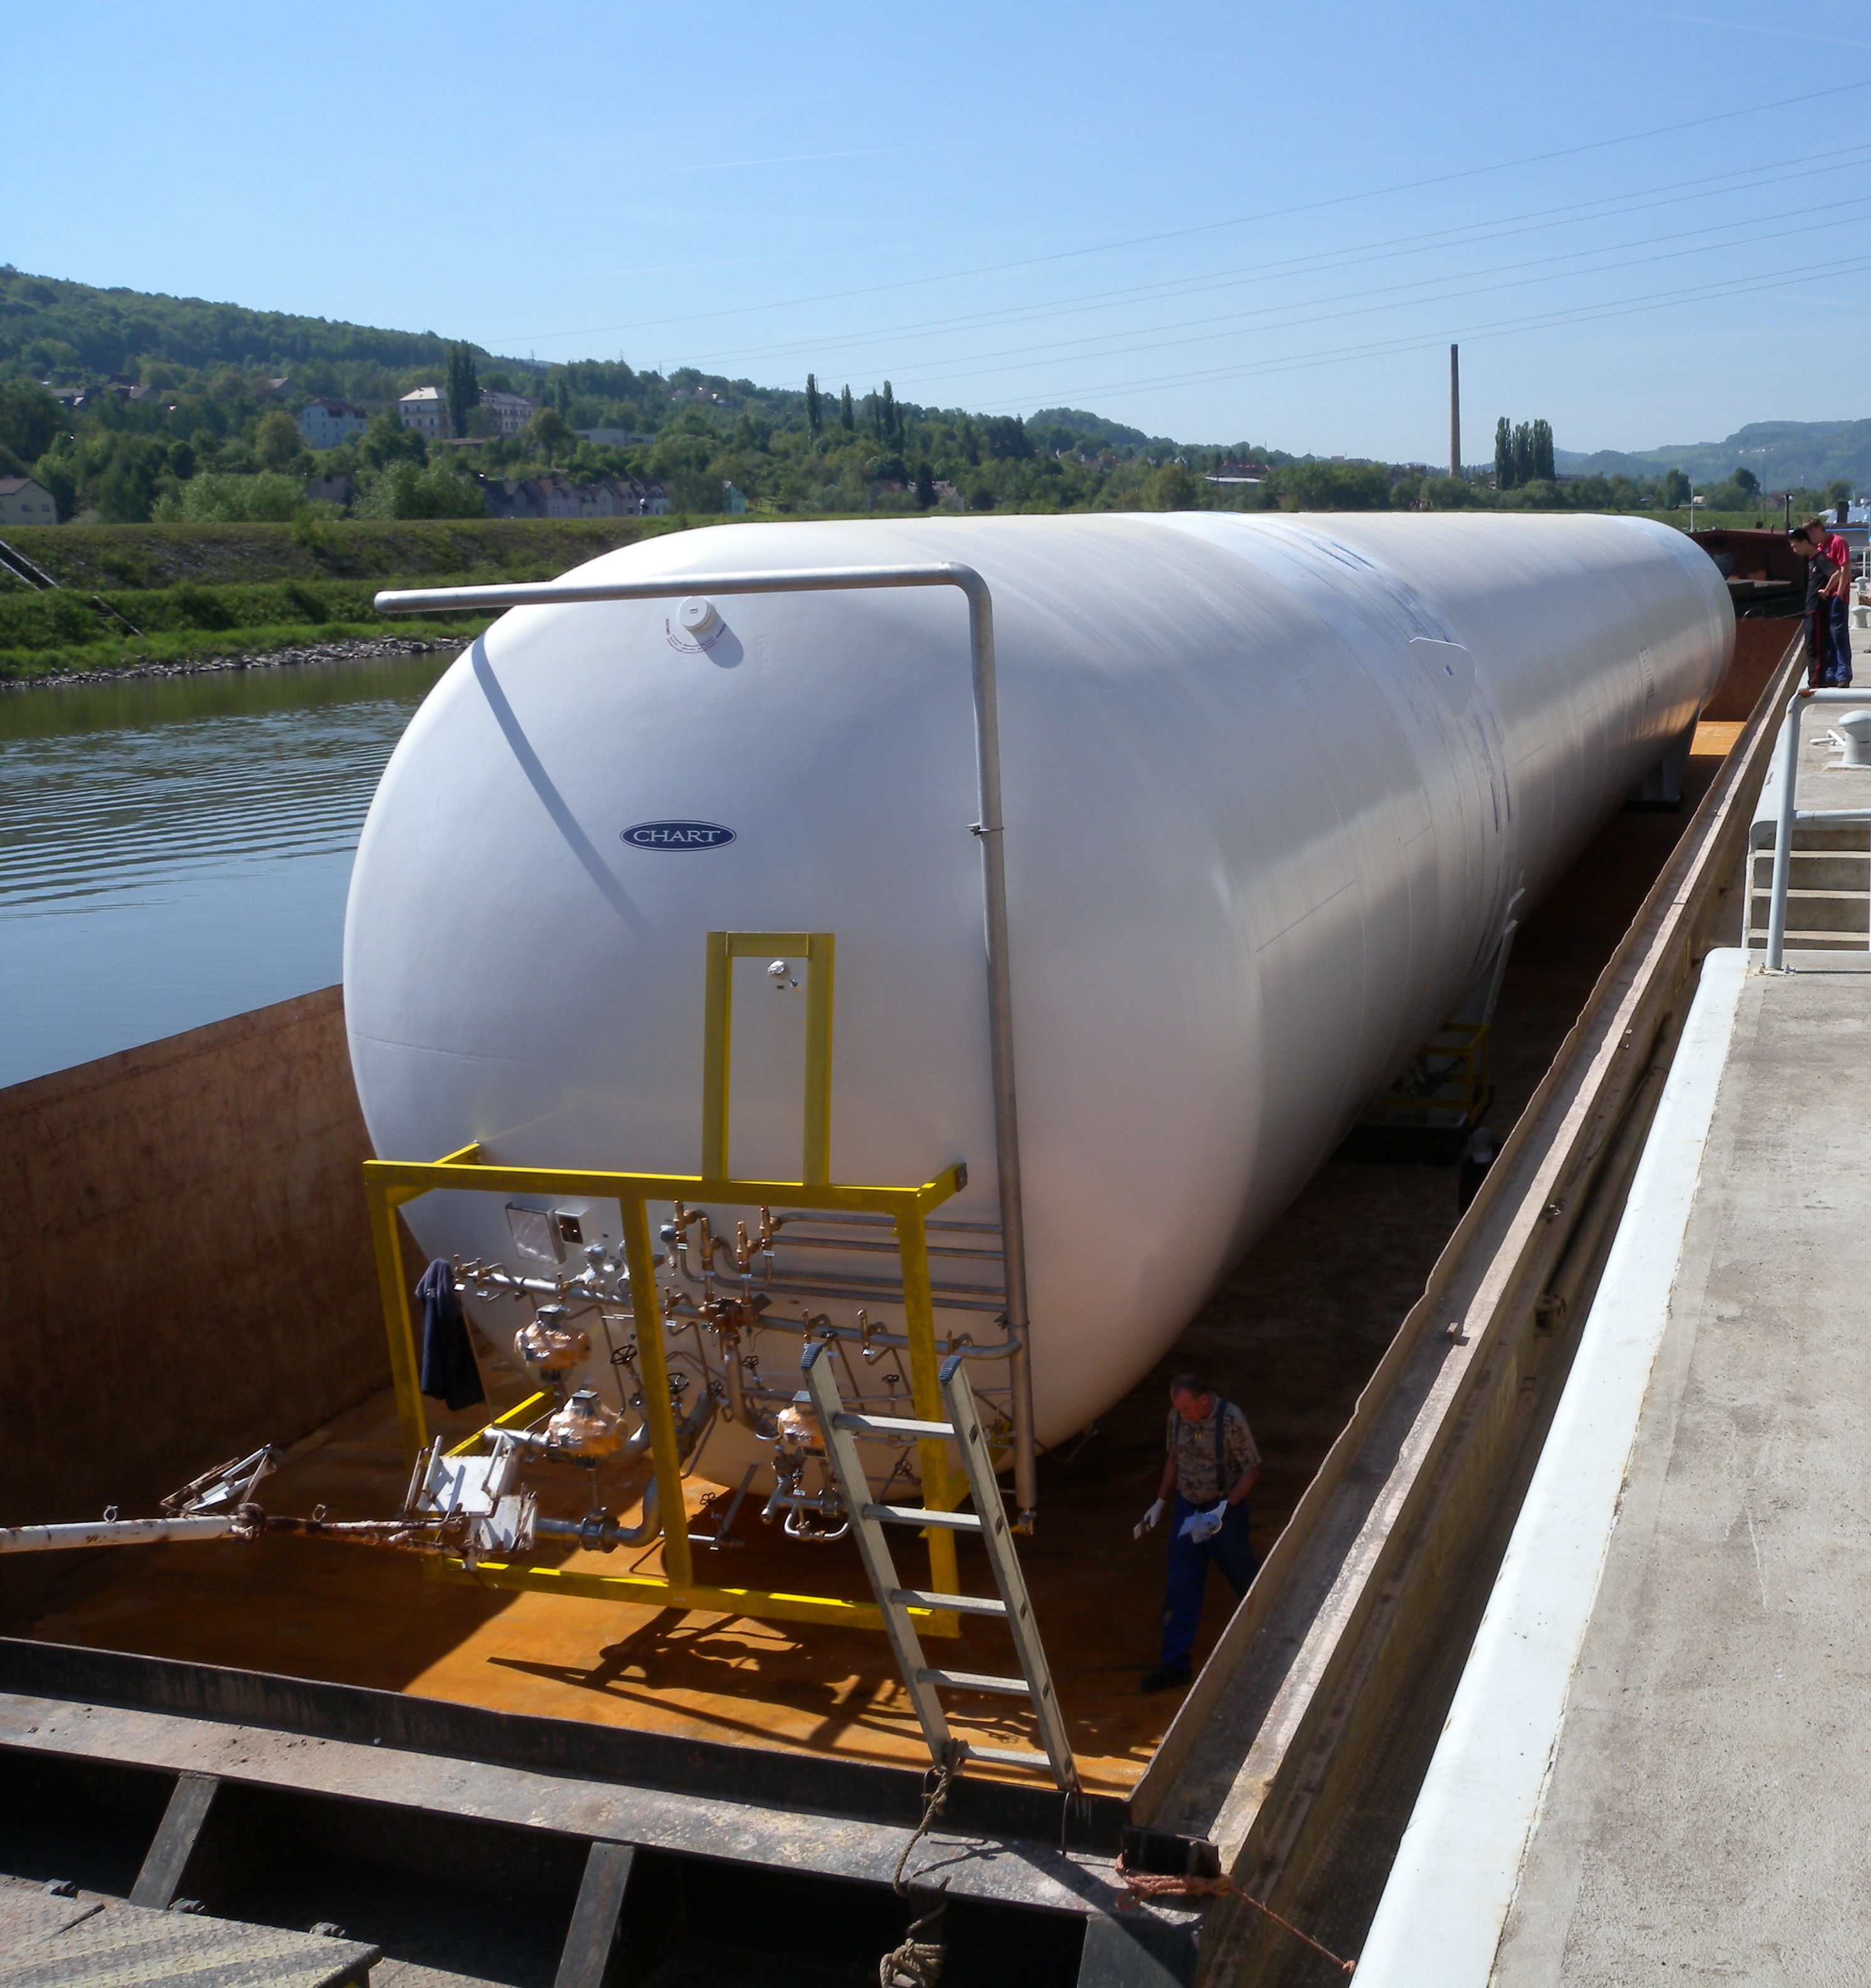
Chart Ferox - Transportation

Slide 7
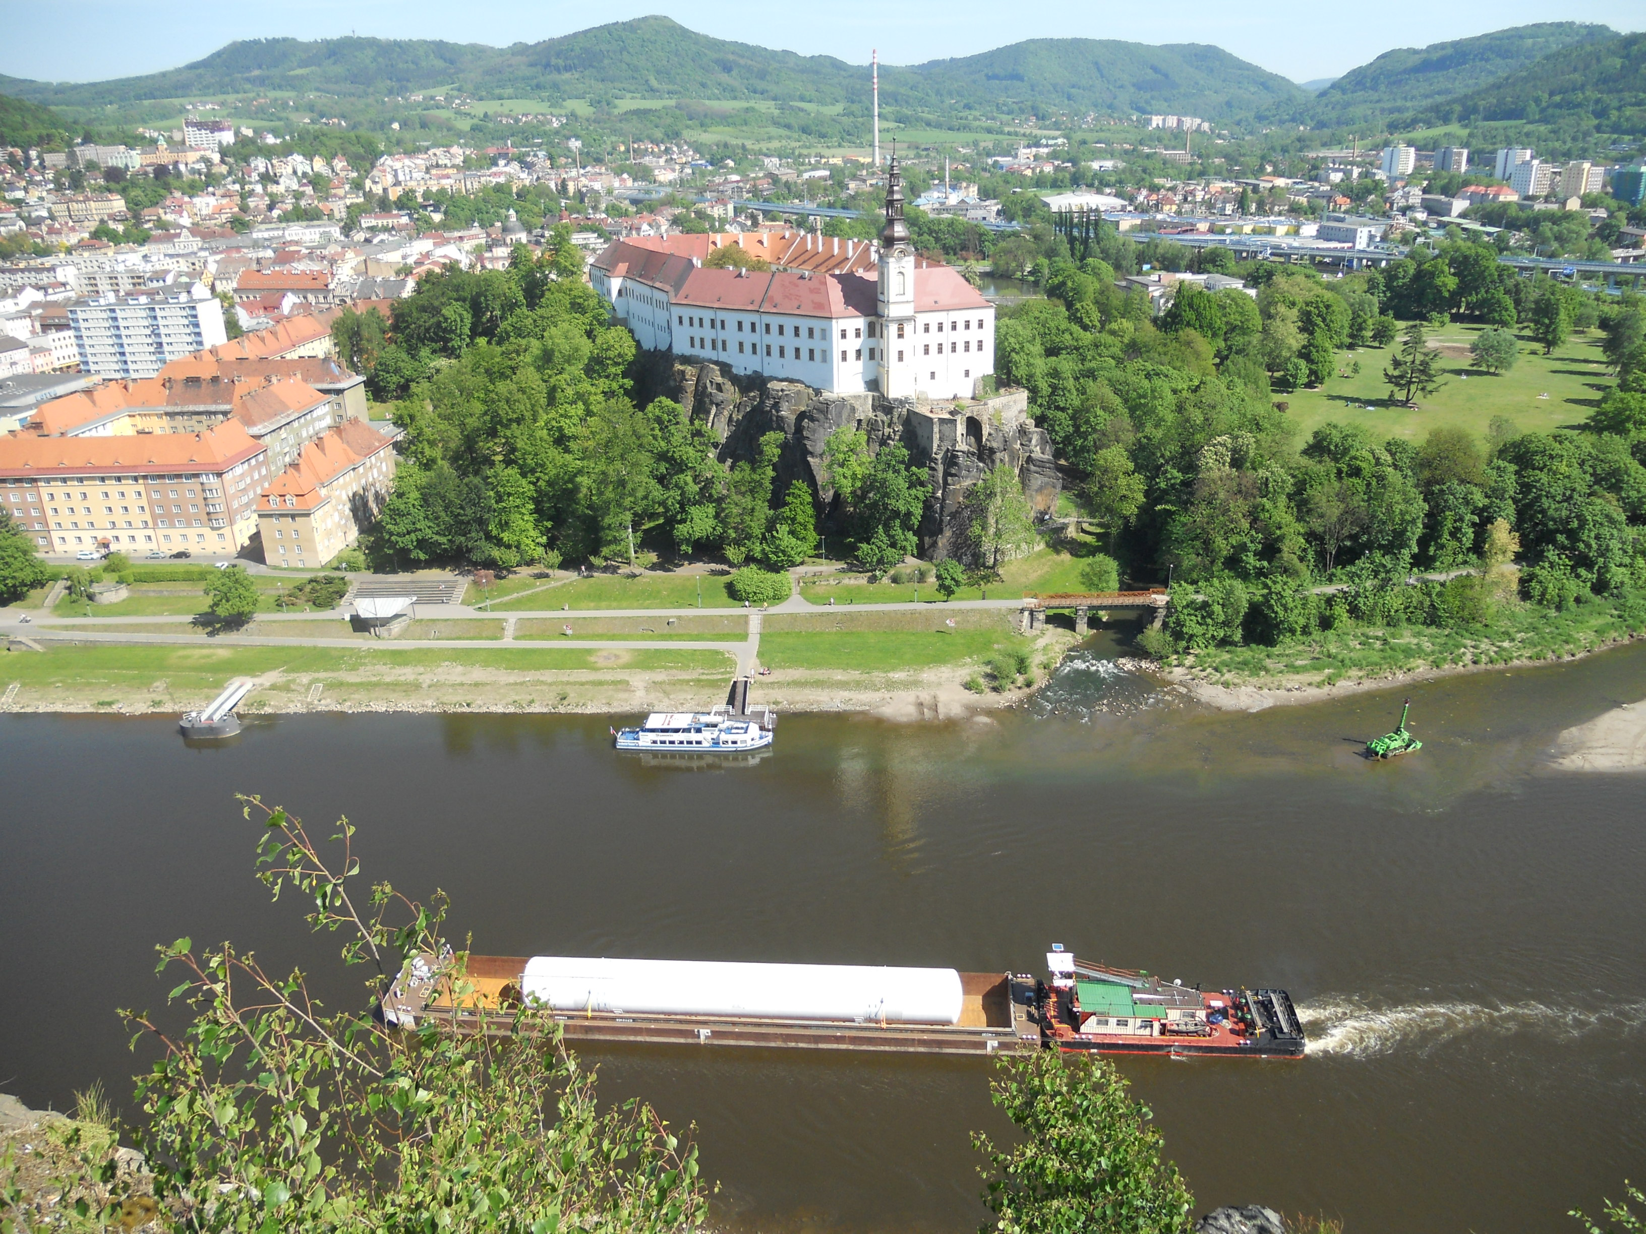
Chart Ferox - Transportation

Slide 8
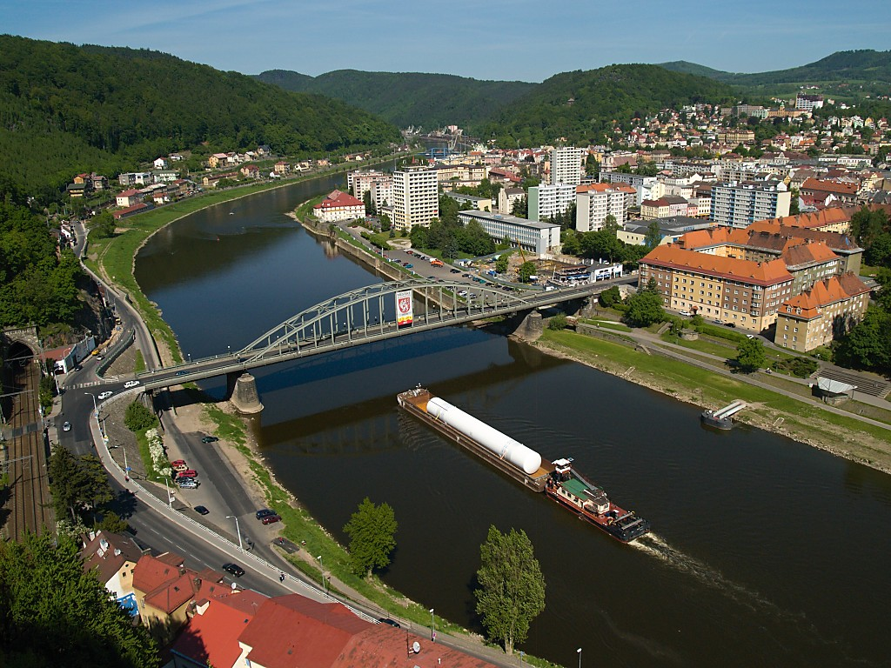
Chart Ferox - Transportation

Slide 9
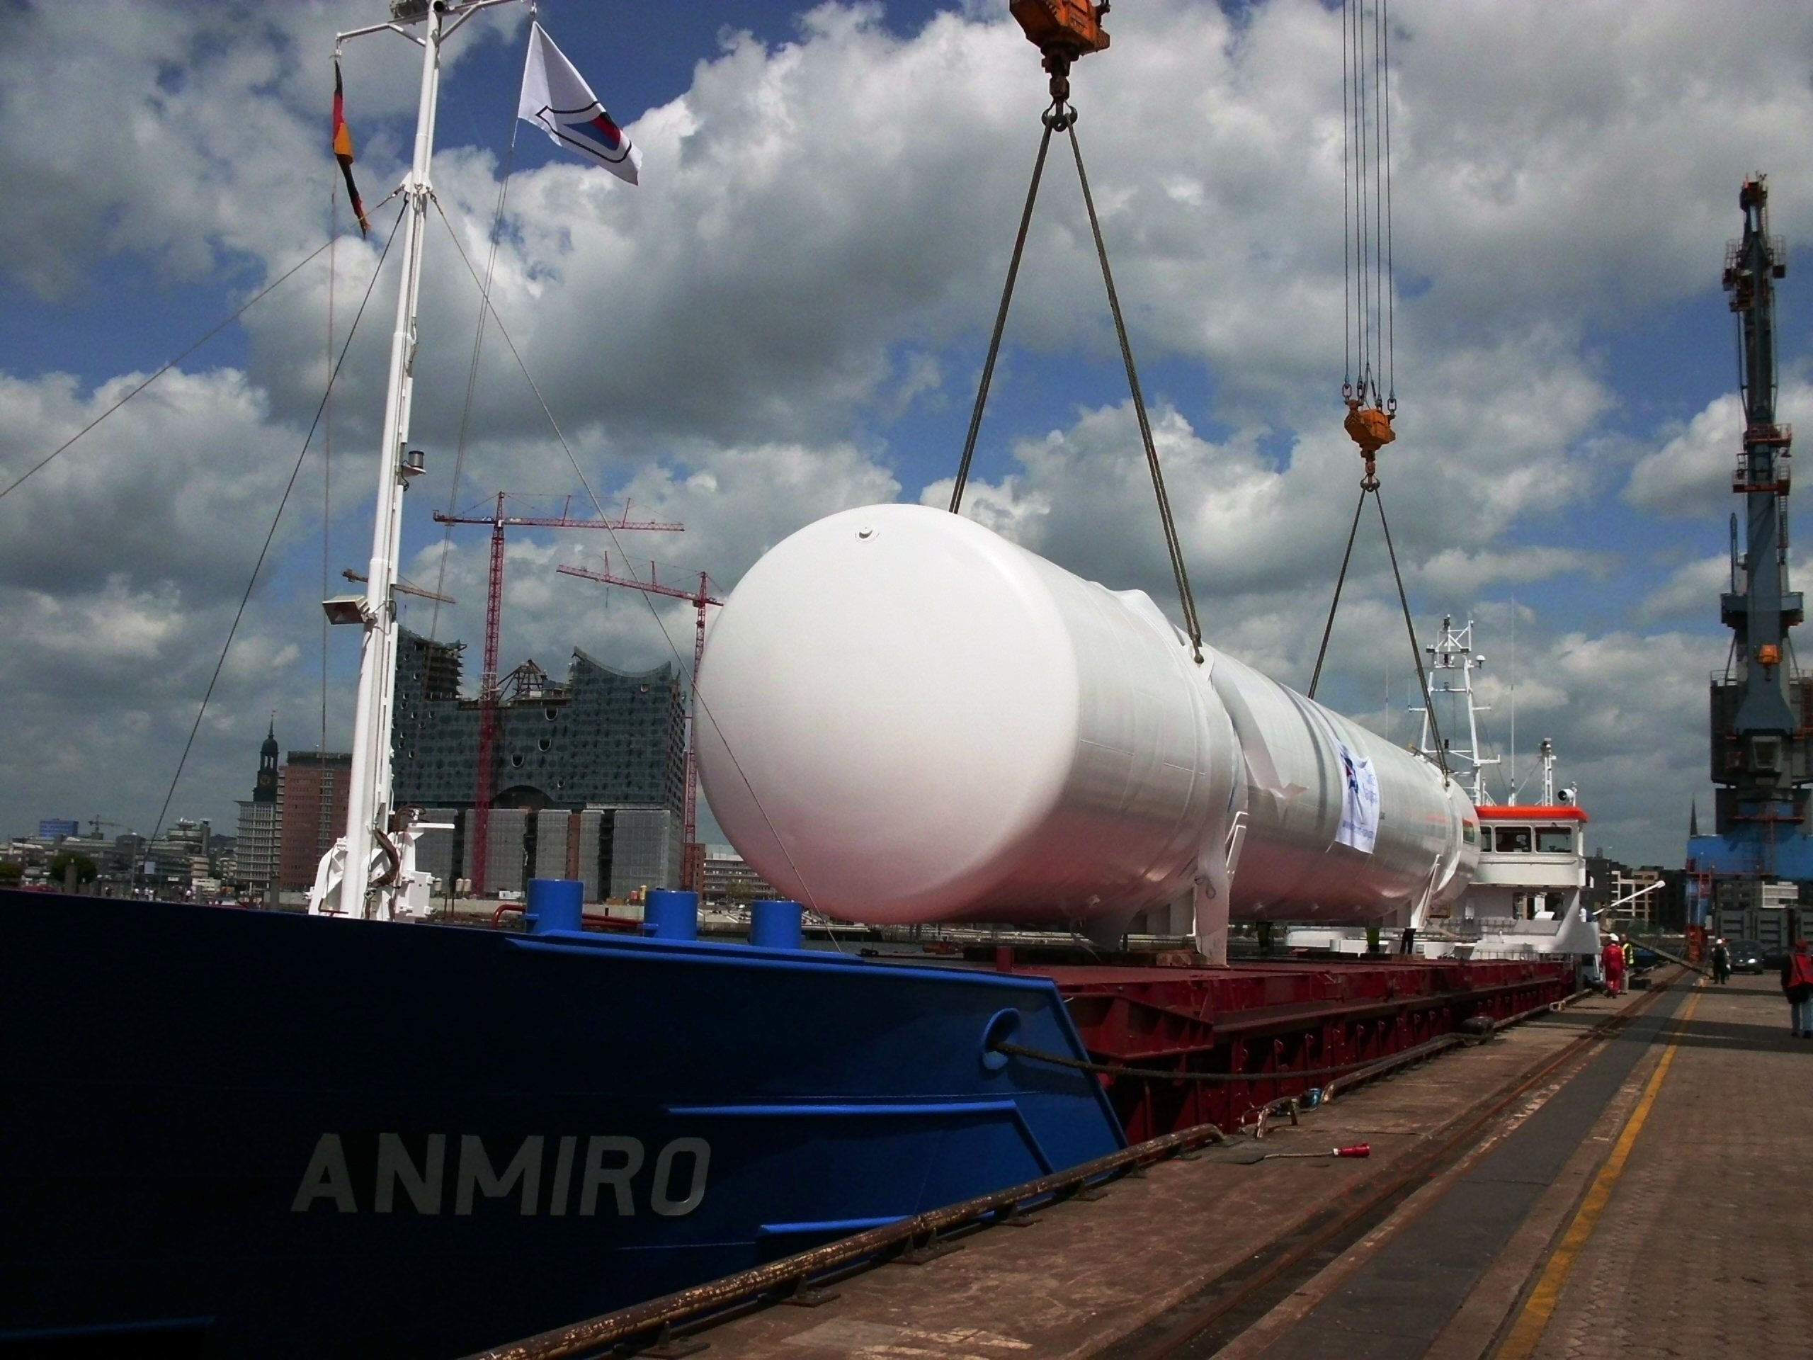
Chart Ferox - Transportation

Slide 10
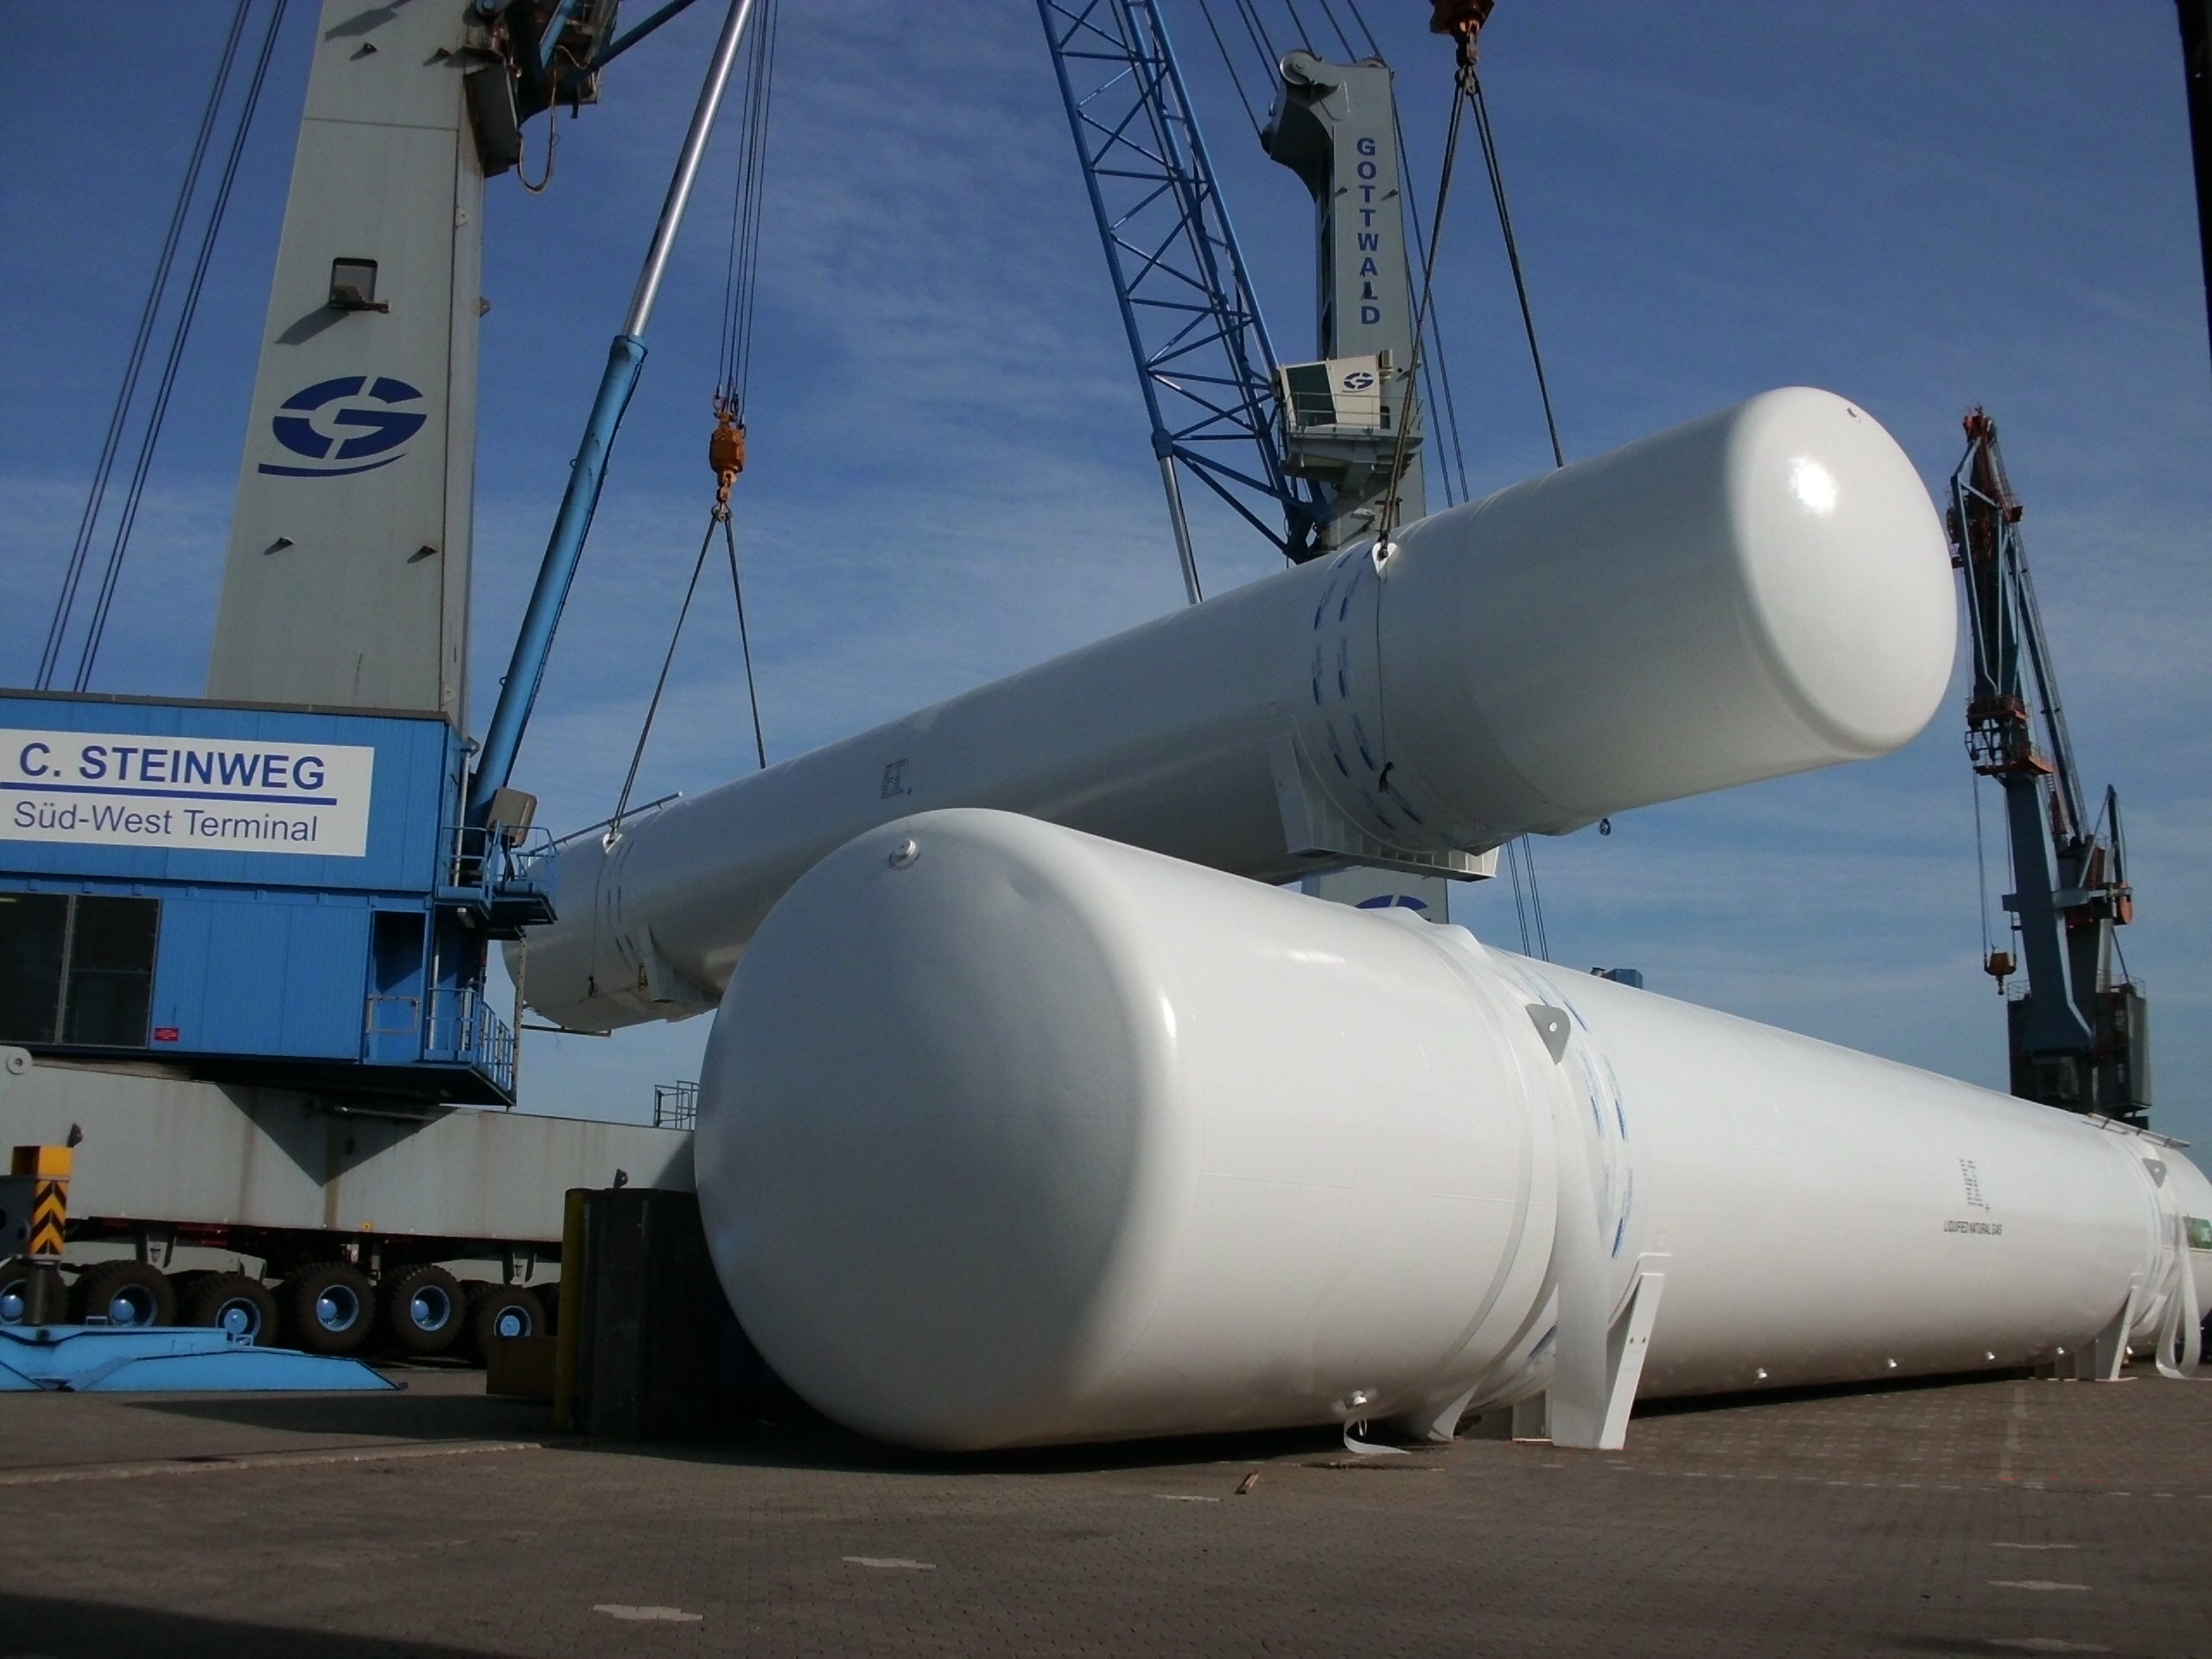
Chart Ferox - Transportation

Slide 11
Basic Premissions
Typical Production Volume – 20% of total production
Represents high content of high value add engineered work
Total ammount could represent up to 200,000 labour hrs/yr = means capacity of 100+ workers/engineers
Keeping the production stable has a significant impact on employment in the Decin region
Keeping the transport flexibility and stability is a major factor to satisfy our customers
Chart Ferox Decin is willing to support all the activities leading to all-year-long navigability of Elbe river

Slide 12





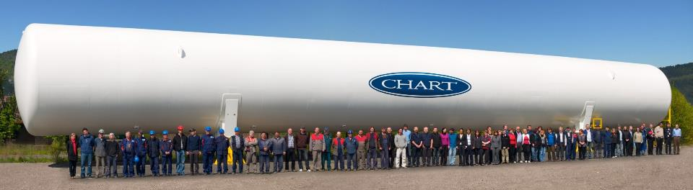
Thank You for Your Attention
www.chartindustries.com

